Slide 1

FED
WE
E
K
Introduction
Front End Development
Diploma in CSF
Year 1 (2021/22), Semester 2
1

Slide 2
Aims of the Module
To develop skills to create responsive web sites;
To develop skills to incorporate multimedia in web pages;
To develop skills to create forms to capture various types of user input with appropriate validation;
To develop skills to add client-side scripting and advanced capabilities.
To develop skills on frontend security.

Slide 3
Learning Objectives
On completion of this module, the students should be able to:
Create web pages using HTML5.
Add graphics and multimedia to web pages using HTML elements.
Use hyperlinks to connect various web pages together.
Capture user input using forms.
Create CSS stylesheets.
Lay out HTML elements using CSS margin and padding.
Implement program logic using JavaScript.
Add advanced functionality to web applications using jQuery and AJAX.

Slide 4
What is Front End Development?
“Front-end web development, is the practice of producing HTML, CSS and JavaScript for a website or Web Application so that a user can see and interact with them directly.
The challenge associated with front end development is that the tools and techniques used to create the front end of a website change constantly and so the developer needs to constantly be aware of how the field is developing.” – Wikipedia

Slide 5
What does a Front End Developer do?
A front end web developer usually works in the visual part of the system, the part that the end user actually uses.
It's about displaying information in a understandable and visualizable format to the user.
That involves using
Basic HTML to create the page
CSS on top to style it, to make it look nice
JavaScript on top of that to add some user interactivity to the page

Slide 6





Languages Taught
HTML5
CSS3
JavaScript
jQuery
AJAX

Slide 7
HTML5
HTML5 is the latest version of HTML.
Modern Web pages and Web applications are generally composed of at least three components, so what people often mean when they say 'HTML5' is the trio of languages: HTML5, CSS3 and JavaScript.
The 'HTML' part contains all the content, organized into a logical structure.
This is the part that an author might be most concerned with: the words, chapter headings, figures, diagrams, etc.

Slide 8

CSS
The 'CSS' part (version 3 being current) is all about the presentation or style of the page; what it looks like without too much regard for the specific content.
It is like the way you might specify a "theme" in a word processing document, setting fonts, sizes, indentations and whatever else may apply to what it looks like.

Slide 9
JavaScript
The 'JavaScript' part is about the actions a page can take such as interaction with the user, and customizing and changing the page according to any number of parameters.
This is what allows a Web page to be more than just a document, but potentially a Web application, with nearly unlimited possibilities.
It is an important leg of the stool for modern Web pages.

Slide 10
jQuery
jQuery is a fast, small, and feature-rich JavaScript library.
It makes things like HTML document traversal and manipulation, event handling, animation, and Ajax much simpler with an easy-to-use API that works across a multitude of browsers.
With a combination of versatility and extensibility, jQuery has changed the way that millions of people write JavaScript.

Slide 11
AJAX
AJAX stand for Asynchronous JavaScript And XML.
While not a technology in itself, it is a term that describes a "new" approach to using a number of existing technologies together, including:
HTML or XHTML, Cascading Style Sheets, JavaScript, The Document Object Model, XML, XSLT, and most importantly the XMLHttpRequest object.
It is able to:
Update a web page without reloading the page
Request data from a server - after the page has loaded
Receive data from a server - after the page has loaded
Send data to a server - in the background

Slide 12
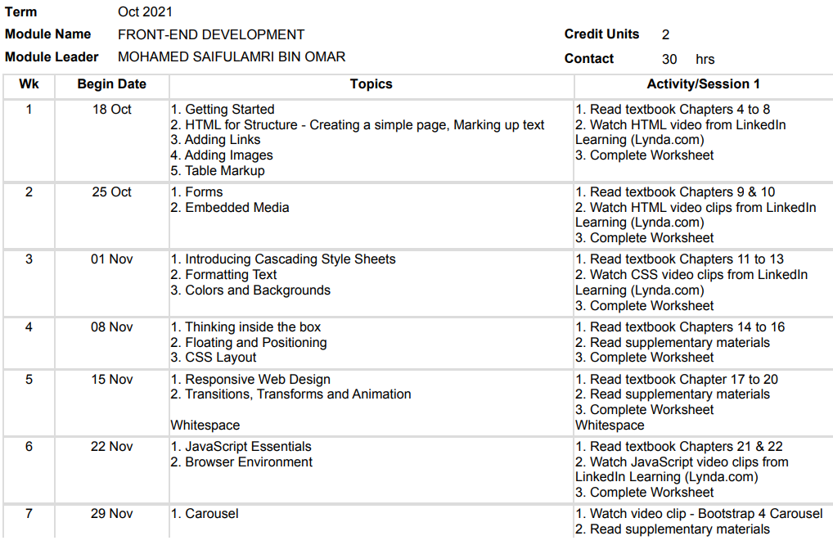
Topics

Slide 13
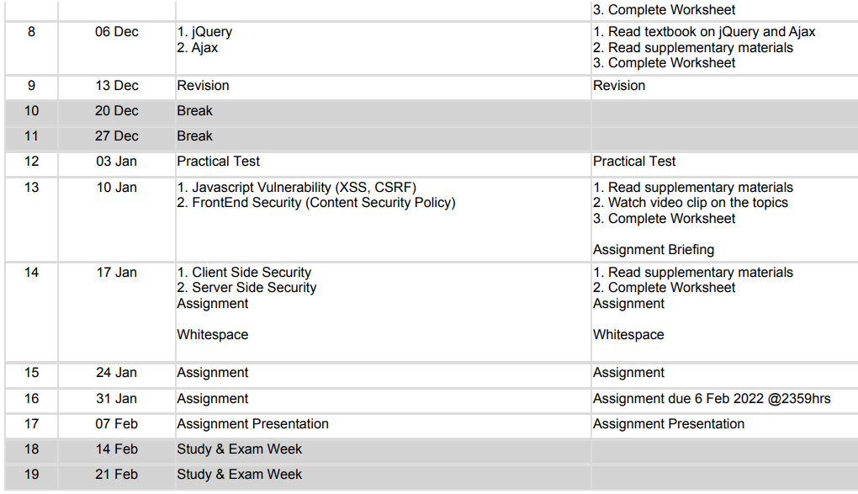
Topics

Slide 14
Assessments
Continuous Assessment (CA) 20%
Weekly submissions 20%
Practical Test 30%
Practical Test (online) (Week 12) 30%
Assignment (Weeks 13 to 16) 50%
Develop a web site (Group)
Assignment presentation on week 17/18

Slide 15
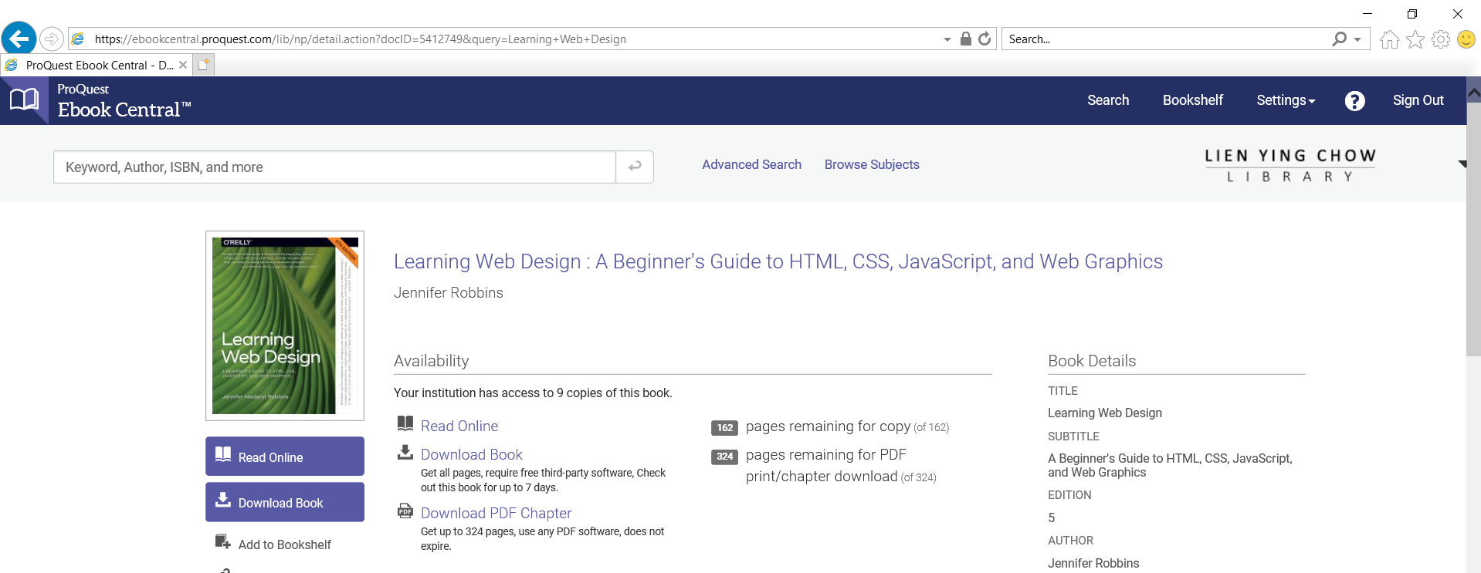

Textbook
Learning Web Design
A Beginner’s Guide to HTML, CSS, JavaScript and Web Graphics
Jennifer Niederst Robbins
Available to download from NP library (VPN and login using NP account):
https://ebookcentral.proquest.com/lib/np/detail.action?docID=5412749&query=Learning+Web+Design
Companion website for the book:
learningwebdesign.com

Slide 16
Learning Mode
100 % Remote Learning (Asynchronous)
However, there is consultation session during time tabled hour
Online collaboration S2S and S2T
Online consultation S2T
Microsoft Teams
However, please note that your tutor reserved the right to call for lessons (HBL or F2F), of which, you have to comply.
Situations where lessons maybe called for but not limited to, include:-
Practical Test
Assignment Presentation
School Directive, etc

Slide 17
Learning Materials
Prescribed text book
Cater for reading/writing learners
Supplementary videos
Cater for visual and auditory learners
Hands-on exercises
Cater for kinesthetic learners
On-going group project
Cater for kinesthetic learners
Encourage group work

Slide 18
Learning Philosophy
If you read (or hear) something, you will know it.
If you write it down you will remember it.
If you can explain it to someone else you will understand it.
You should always aim to understand, not just know or remember.
So write the sample codes and get a study buddy and discuss the code with each other.

Slide 19
Resources
Textbook
Slides - download from MeL
Practical Exercises - download from MeL
Videos - links to be given
Visual Studio - for hands-on
MEL - for submission of weekly work
Microsoft Teams – for communication as well as feedback

